Slide 1
Interpreting Correlations

Slide 2
Correlation is a statistic that measures the degree to which two metrics move in relation to each other.

Slide 3
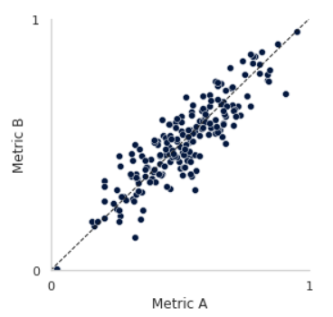
Correlation Analysis
+ 0.9
Both metrics are normalized on a scale from 0 to 1
A correlation coefficient is a unit less number ranging from -1 to 1
1 = Perfect positive correlation
-1 = Perfect negative correlation
0 = No correlation what-so-ever

Slide 4
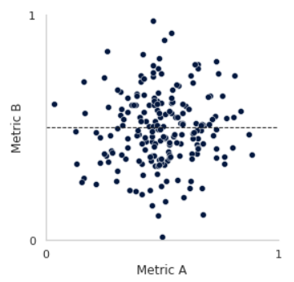
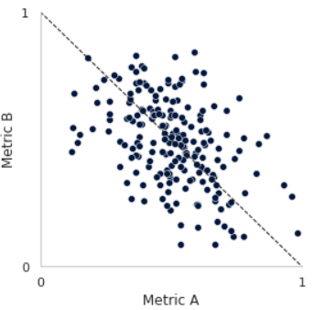
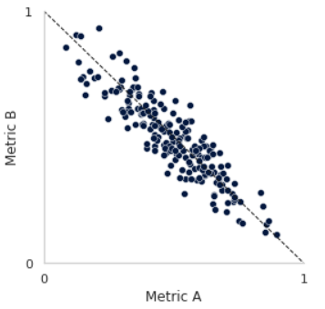
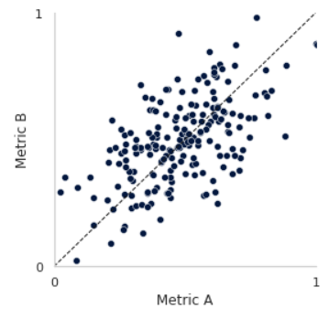
Examples
+ 0.9
+ 0.5
0
- 0.5
- 0.9
High Positive
Correlation
No
Correlation
High Negative
Correlation
Range | Interpretation
> 0.8 | Suspiciously High
0.6 – 0.8 | Strong
0.4 – 0.6 | Moderate
< 0.4 | Weak

Slide 5
Things to Know
Because everything is normalized, correlations don’t tell us exactly how metrics are related only the degree to which they are related
Very useful for quickly identifying relationships to explore further with regression or other types of analysis
A correlation coefficient alone can hide things and be potentially misleading
Correlation ≠ Causation

Slide 6
What’s in a number?
Things to look out for

Slide 7
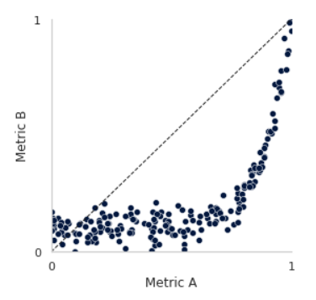
L Shaped
+ 0.6
Undervalues correlation when comparing to other relationships.

Slide 8
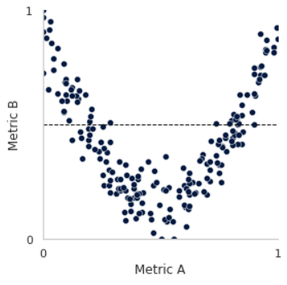
V Shaped
0.0
V shaped curves do not have a linear relationship

Slide 9
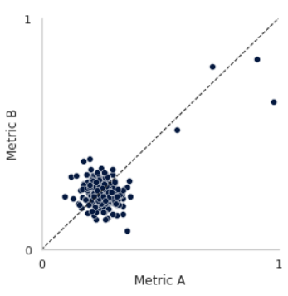
Extreme Outliers
+ 0.6
Extreme outliers can trick the analysis into thinking there is a correlation

Slide 10
Key Takeaway #1
Correlation coefficients are a good way of quickly analyzing and comparing metrics to find strong relationships, but it can miss things.

Slide 11
Real data is messy
An example

Slide 12
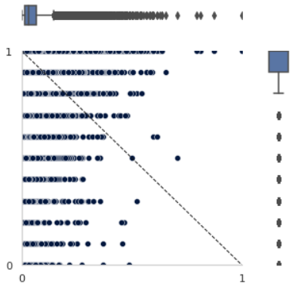
Patient Experience
- 0.1
Surgical Delay Time vs Facility Rating
We expect that surgical delay should lead to lower facility rating
An analysis of 32,000+ outpatient cases shows NO correlation
Need to rework the analysis
10
Facility Rating
0
Delay Time

Slide 13
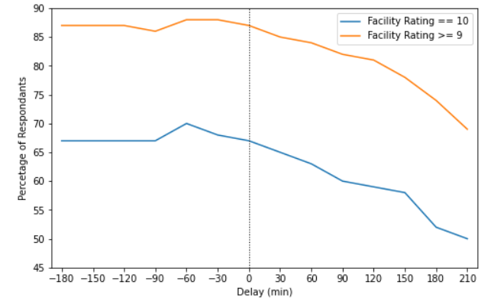
Patient Experience
Surgical Delay Time vs Facility Rating
Focus on Percentage of Top Box responds vs Delay Time
There it is →

Slide 14
Key Takeaway #2
Correlation analysis isn’t always the right approach to evaluate relationships, but it is a good start.

Slide 15
Chicken or the egg?
Maybe it was a Martian

Slide 16
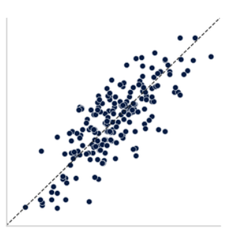
Correlation ≠ Causation
Formula Consumption vs
Diaper Volume
Metrics can be highly correlated but have little affect on the other
This occurs when two metrics are highly depended on a third metric
These are informative, but cannot be used in causal analytics
← Diaper Volume
Formula Consumption →

Slide 17
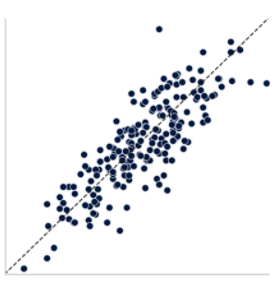
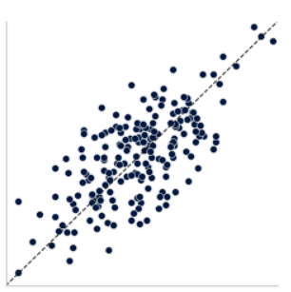
Correlation ≠ Causation
Formula Consumption vs
Diaper Volume
Metrics can be highly correlated but have little affect on the other
This occurs when two metrics are highly depended on a third metric
These are informative, but cannot be used in causal analytics
← Diaper Volume
Births →
← Formula Cons
Births →

Slide 18
Key Takeaway #3
Correlation analysis cannot tell us if one metric is dependent on the another, only that they move together.

Slide 19
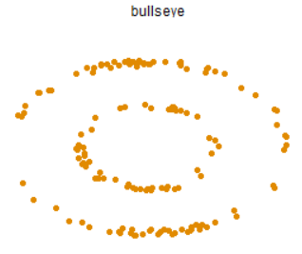
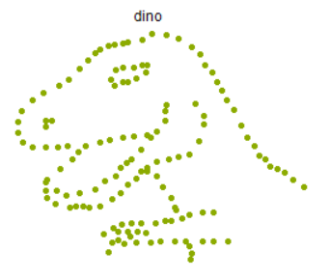
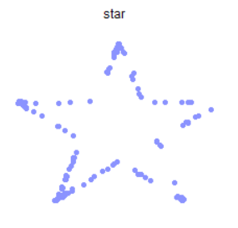
Numbers never tell the whole story
Metric A – Average | 54.3
Metric A – Std Dev | 16.8
Metric B – Average | 47.8
Metric B – Std Dev | 26.9
Correlation | -0.06

